Slide 1

REMOTE MONITORING OF INDUCTION MOTOR
KUMARAGURU COLLEGE OF TECHNOLOGY
DEPARTMENT OF ELECTRICAL AND ELECTRONICS ENGINEERING
PROJECT GUIDE: Prof.V.Kandasamy
STUDENT’S NAME:
J.U.PAVITHRAN(12BEE036)
M.P.SAKTHIVEL(12BEE041)
R.ARANGANATHAN(12BEE004)

Slide 2
CONTENT
INTRODUCTION
EXISTING METHOD OR LITERATURE SURVEY (FOR IEEE PAPERS)
OBJECTIVE OF THE PROJECT
BLOCK DIAGRAM
CIRCUIT DIAGRAM
METHODOLOGY/ALGORITHM
HARDWARE DESIGN/COMPONENTS
WORKING MODEL SNAP SHOT OF HARDWARE
CONCLUSION AND FUTURE SCOPE
REFERENCES

Slide 3
INTRODUCTION
Nowadays with the emergence of Internet of Things(IOT),the Monitoring and controlling of machines have become much simpler and can be manipulated from any part of the world
The proposed idea will focus on monitoring of induction motor through a Web App powered by NodeJS as backend and using Arduino.

Slide 4
EXISTING METHODS/ LITERATURE SURVEY
The existing monitoring solutions are offline and doesn't provide control over HTTP protocol so the application is limited to small distance only.
Also this monitoring system uses NodeJS as backend ,so the whole web can be manipulated Eg:- posting updates to Twitter,facebook,alerts to mobile phone through Twilio API...etc,
Also the application is cross-platform that can be used in android,ios,windows or any other platform.

Slide 5
OBJECTIVE
Monitoring the induction motor remotely, facilitates the user to have full control over the application where the motor is put to use.
so the idea will be greatly useful in Industrial Automation and Home automation applications which uses induction motor as the actuator.

Slide 6
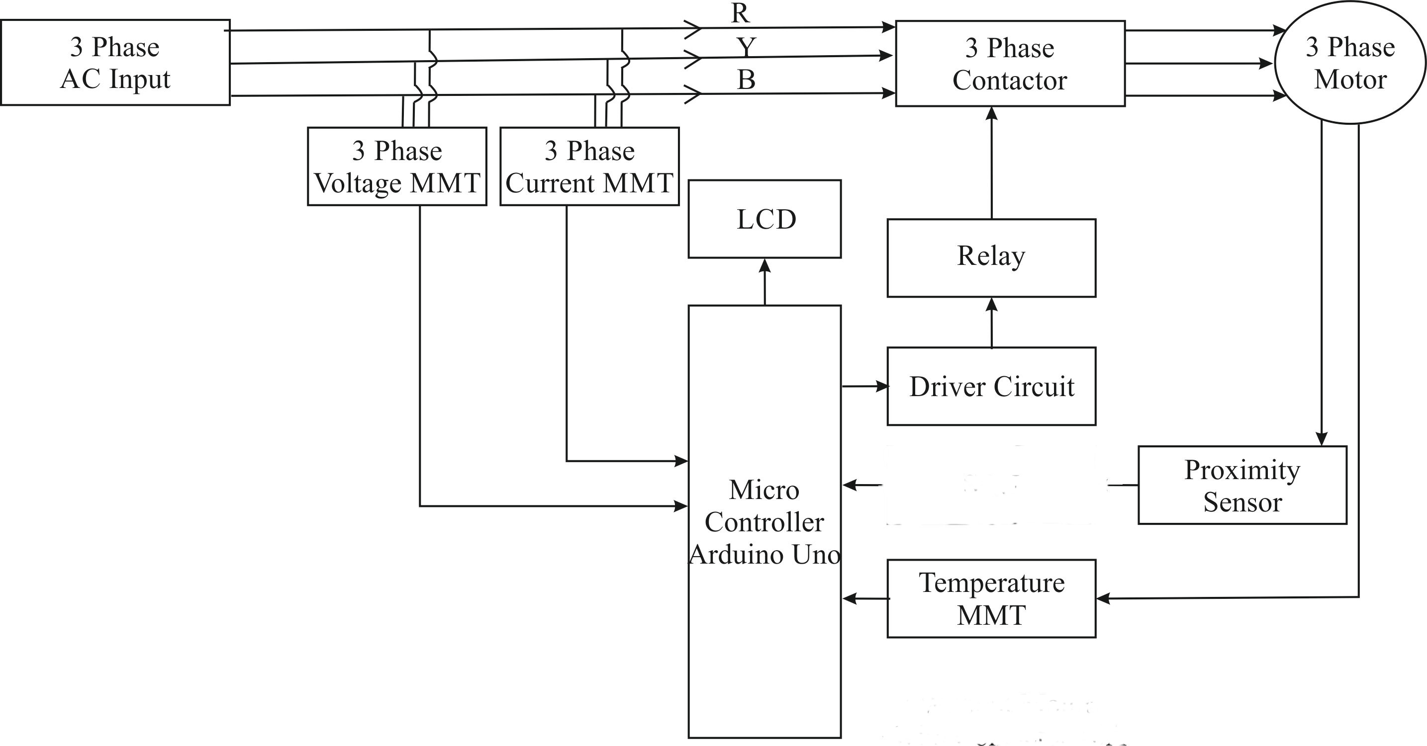
BLOCK DIAGRAM

Slide 7
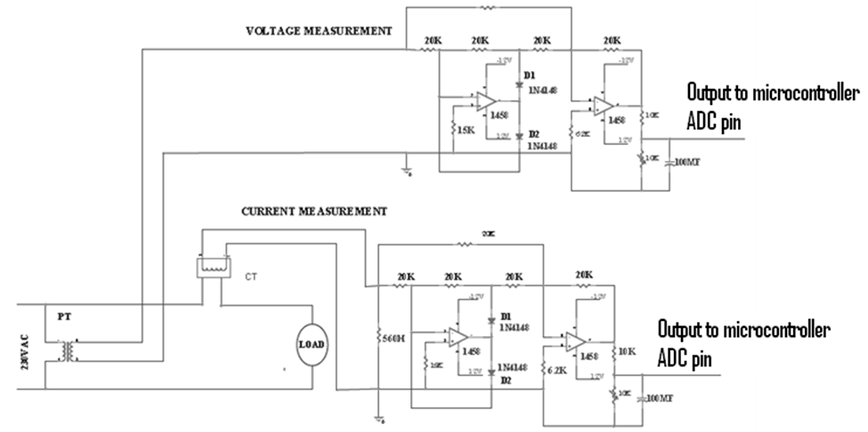
CIRCUIT DIAGRAM

Slide 8
METHODOLOGY
Embedded Hardware- Arduino UNO.
Sensors used -speed sensor,Temperature sensor(LM35).
CT’s & PT’s are used for Current and Voltage Measurement
Web-Hosting- www.000webhost.com
ON/OFF motor using Contactor.
Thingspeak API for pushing data to cloud from arduino.
Google Polymer for designing the cross-platform web app.

Slide 9
PARAMETERS MEASURED
Temperature of motor.
Speed of motor.
Load Current .
Load Voltage .

Slide 10
HARDWARE COMPONENTS
Arduino UNO
3-Phase Induction Motor
Speed sensor
Temperature sensor(LM35).
Current Transformer
Potential Transformer
Relay
Contactor
ESP8266(Wifi-module)
LCD Display

Slide 11
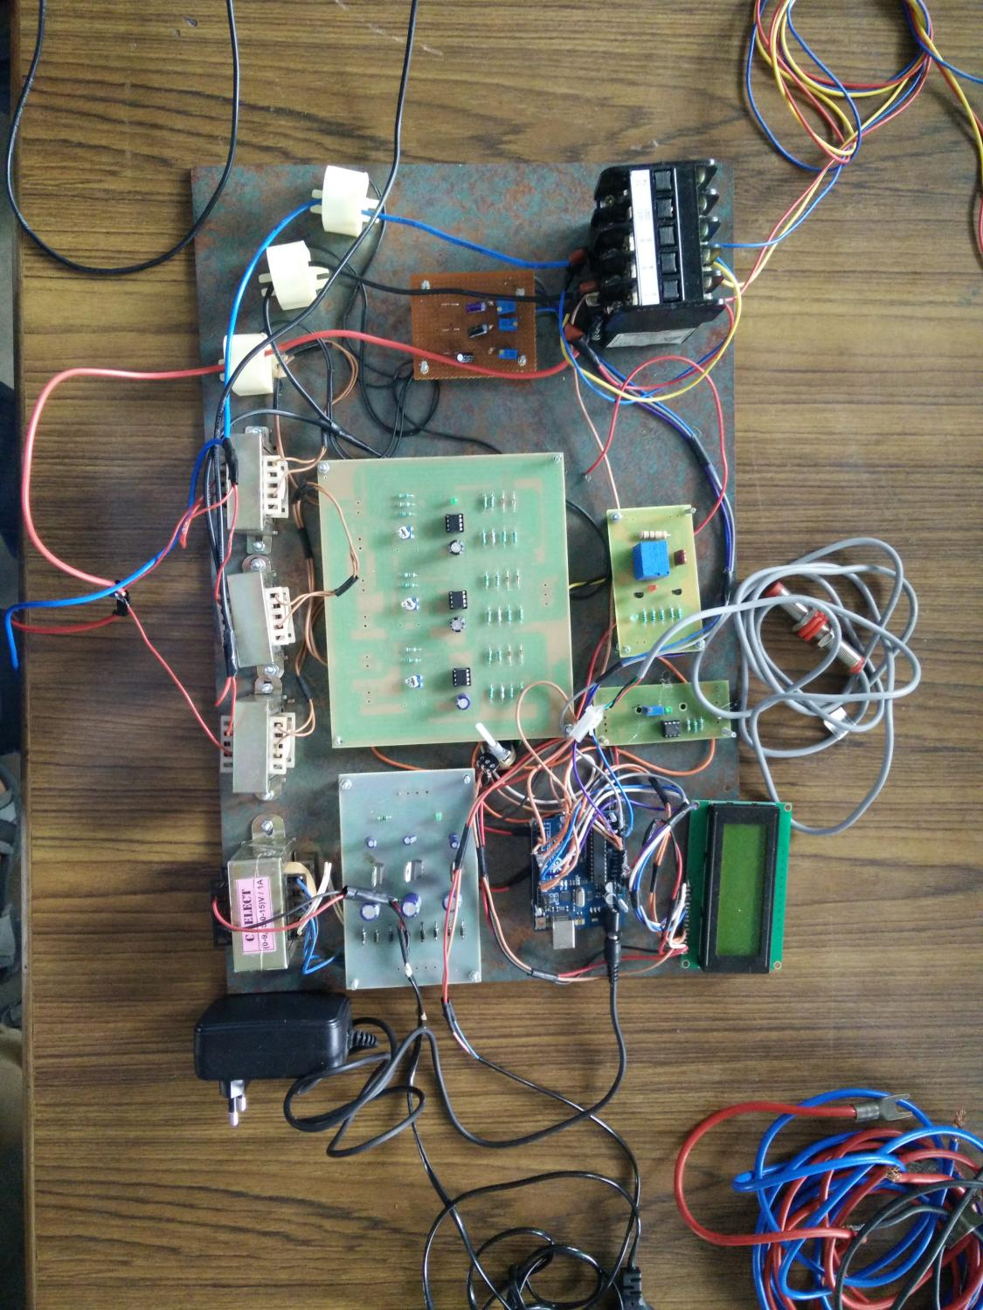
WORKING MODEL /SNAP SHOT

Slide 12
CONCLUSION
The remote monitoring enables the user to log the data to the database
Consequently,combining with Neural Networks we can know when the error is going to occur
Also using Big-Data Analysis ,we can know how much loss in the Production has been occurred .

Slide 13
REFERENCE
http://www.intorobotics.com/build-robot-without-arduino-shield-r3-dc-stepper-motors-controlled
https://www.openhomeautomation.net/internet-of-things-dashboard
https://www.arduino.cc

